Slide 1

Musite| Download| Tutorial |Support |
Home
SUBMISSION:
Accessions:
Input comma-separated accessions (limit of 10). example
UniProt
:
OR
Sequence:
Input protein sequence(s) in FASTA format (limit of 10). example
OR
Sequence:
Input protein sequence(s) in FASTA format (limit of 500) by e-mail, and the predicted result will be sent to you by e-mail once completed. ). example
Your e-mail address:
Upload file:
Browser
SECLECTION:
Ser
Thr
Tyr
Submit
Cancel

Slide 2
Musite| Download| Tutorial |Support |
Home
Result
Results of Sequence 1:
Show:
Sequence
Slider
Table
>Sequence 1 name
1 MERSPAVCCQ DPRAELVERV AAISVAHLEE AEEGPEPASN GVDPPPRARA ASVIPGSASR
61 PTPVRPSLSA RKFSLQERPA GSCLEAQVGP YSTGPASHMS PRAWRRPTIE SHHVAISDTE
121 DCVQLNQYKL QSEIGKGAYG VVRLAYNERE DRHYAMKVLS KKKLLKQYGF PRRPPPRGSQ
181 APQGGPAKQL LPLERVYQEI AILKKLDHVN VVKLIEVLDD PAEDNLYLVF DLLRKGPVME
241 … …
Show
5
entries
Ordinal # | Position | Peptides | Scores
1 | 4 | * * *MERSPAVCCQ | 0.85
2 | 39 | EGPEPASNGVDPP | 0.75
3 | 59 | VIPGSASRPTPVR | 0.82
4 | 67 | PTPVRPSLSARKF | 0.85
5 | 74 | LSARKFSLQERPA | 0.80
Results of Sequence 2:
Show:
Sequence
Slider
Table
… …
Filtered
All
Download

Slide 3
Musite| Downloads| Tutorial |Support |
Home
Downloads
PTM type:
Ser
Thr
Tyr
Species type:
Homo sapiens
Mus musculus
Drosophila melanogaster
Caenorhabditis elegans
Saccharomyces cerevisae
Arabidopsis thaliana
Download
All Datasets
Notes:
(1) The Dataset were classified with the PTM types, i.e. S, T, Y;
(2) For the PTM sites, “E” means ;”D” means …
(3) …

Slide 4
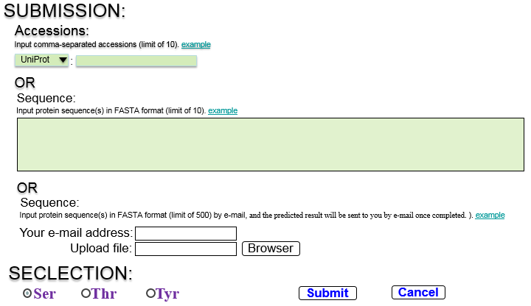
Musite| Downloads| Tutorial |Support |
Home
Tutorial
1. Web Form Submission Outline
  Choose an accession type.
  Input accession.
  Click the example link to see an example of a valid accession input.
  Input up to 10 protein sequences in FASTA format.
  Click the example link to see examples of valid protein sequence input.
  Input the items when you want to predict the sites by uploading file.
  Choose the PTM type.
  Submit or clear input.
❸
❶
❷
❺
❹
❻
❼
❽

Slide 5
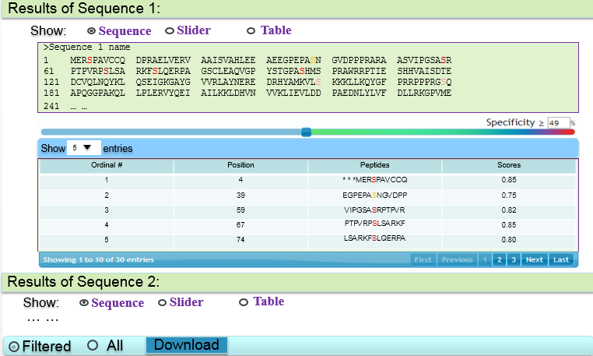

Musite| Downloads| Tutorial |Support |
Home
Tutorial
2. Output Outline
Choose the output features you would like to view.
Protein sequence with predicted sites highlighted.
Enter a percentage or move the slider to choose a specificity.
Table of all output data. Click on a column header to sort on that column.
Download output. Choose Filtered to only download output above the currently selected specificity. Choose All to download all output.
Demo Video
❶
❷
❸
❹
❺
3. Demo Video.
Watching
❻

